Slide 1
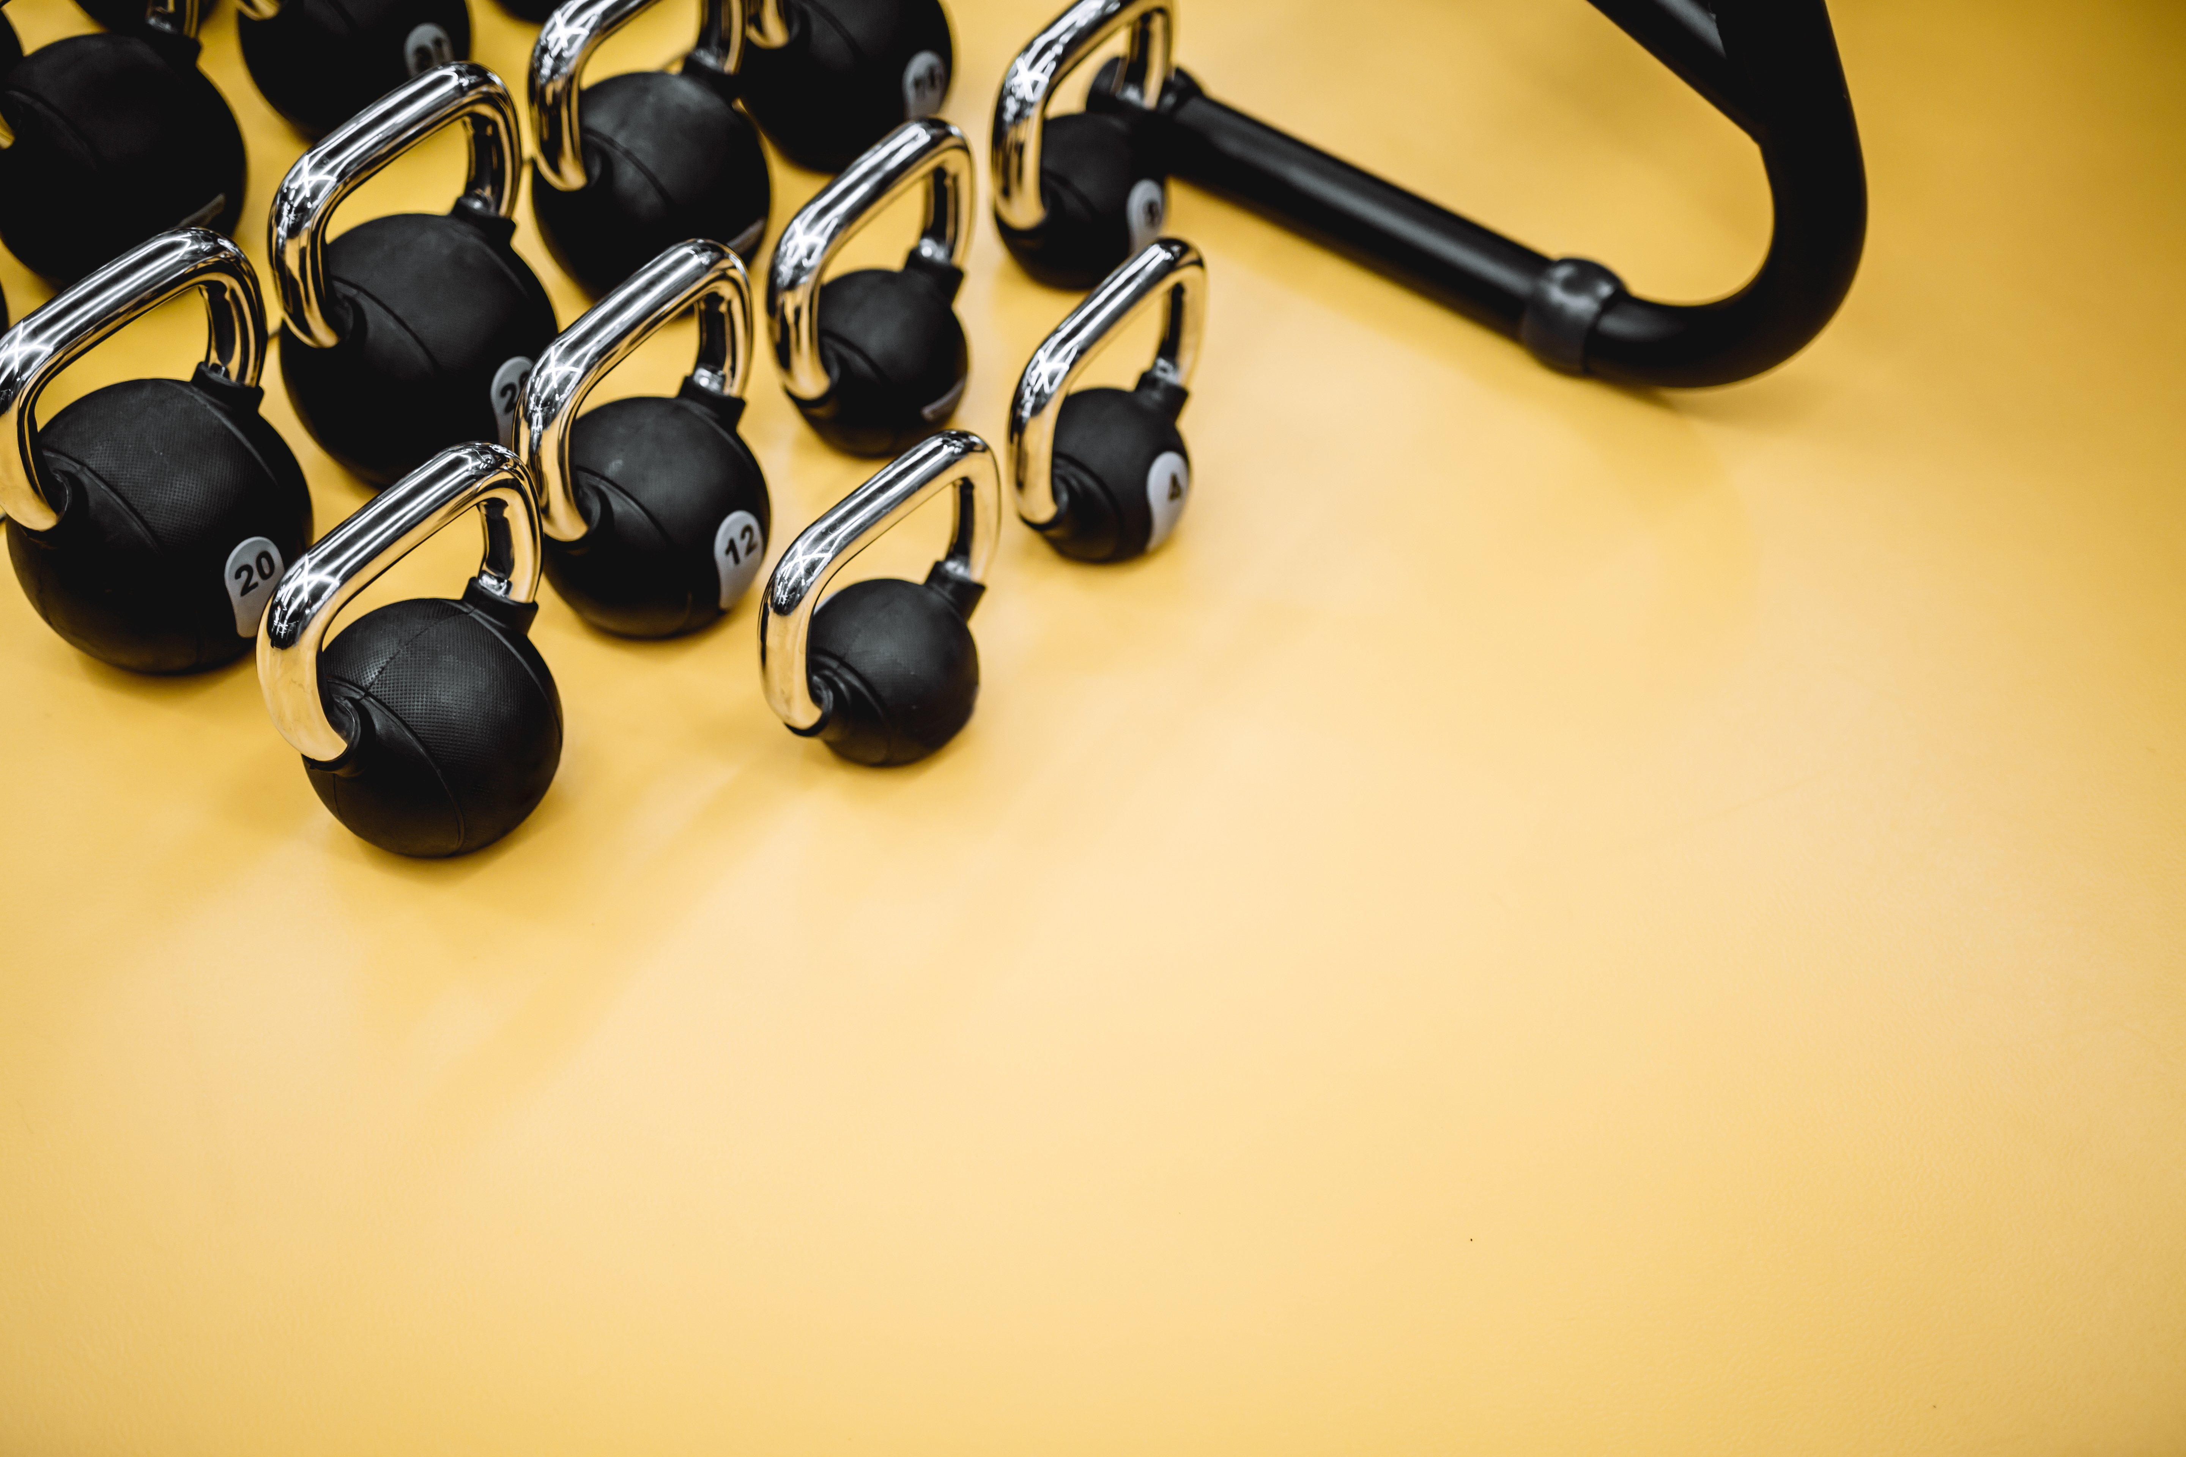

MS-SC Graduate Outcomes
Survey Year | Response/ Knowledge Rate | *Working | *Not Seeking | *Continuing Education | *Military | *Volunteering | *Still Looking | *Satisfactorily Occupied
AY 24 (FA 24) | 86% | 66% | 0% | 17% | 0% | 17% | 0% | 100%
AY 23 (FA 23/SP 24/SU 24 ) | 70% | 85% | 0% | 5% | 0% | 5% | 5% | 100%
AY 22 (SP 23/SU 23) | 79% | 80% | 0% | 10% | 0% | 0% | 10% | 90%
*the % of surveys completed

Slide 2
Employers Who Have Hired Our Graduates
Averett University
Central Institute for Human Performance
Champion Chiropractic and Sport Injury Clinic
Cleburn County Board of Education
D1 Training
D1 Sports Franchise, LLC
Elite Sports Injury Therapies
Erie Sports Now Fitness & Performance Center
Exos
Gavilan College
Georgetown University
Graham Fitness
Impact Physical Therapy
Indianapolis Colts
Jack Britt High School
Kent State University
Logan University
Long Island University
Maricopa County
MedTrust LLC
Midland University
Ministry of Education
MuscleNerd Strength Training & Coaching
PAP Sports
Parisi Speed School St. Louis
Pure Motion Athletics
Riverview Gardens School District
Stevenson University
Texas Christian University
The College of Wooster
Tulane University
United States Army
University of Connecticut
Wellsville Local School District
William Jessup University

Slide 3
Sample Job Titles of MS-SC Graduates
Adaptive Physical Education Instructor
Head Strength and Conditioning Coach
Strength and Conditioning Coach
Head Sports Performance Coach
Speed and Fitness Performance Coach
Coach
Owner
Physical Therapy Technician
Teacher
Technician
Director of Sports Performance
Assistant Coach
Trainer
Assistant Football Strength & Conditioning Coach
Sports Performance Coach
Assistant Strength and Conditioning Coach
Exercise Physiologist
Defensive Backs Coach
Graduate Assistant Sports Performance Coach

