Slide 1
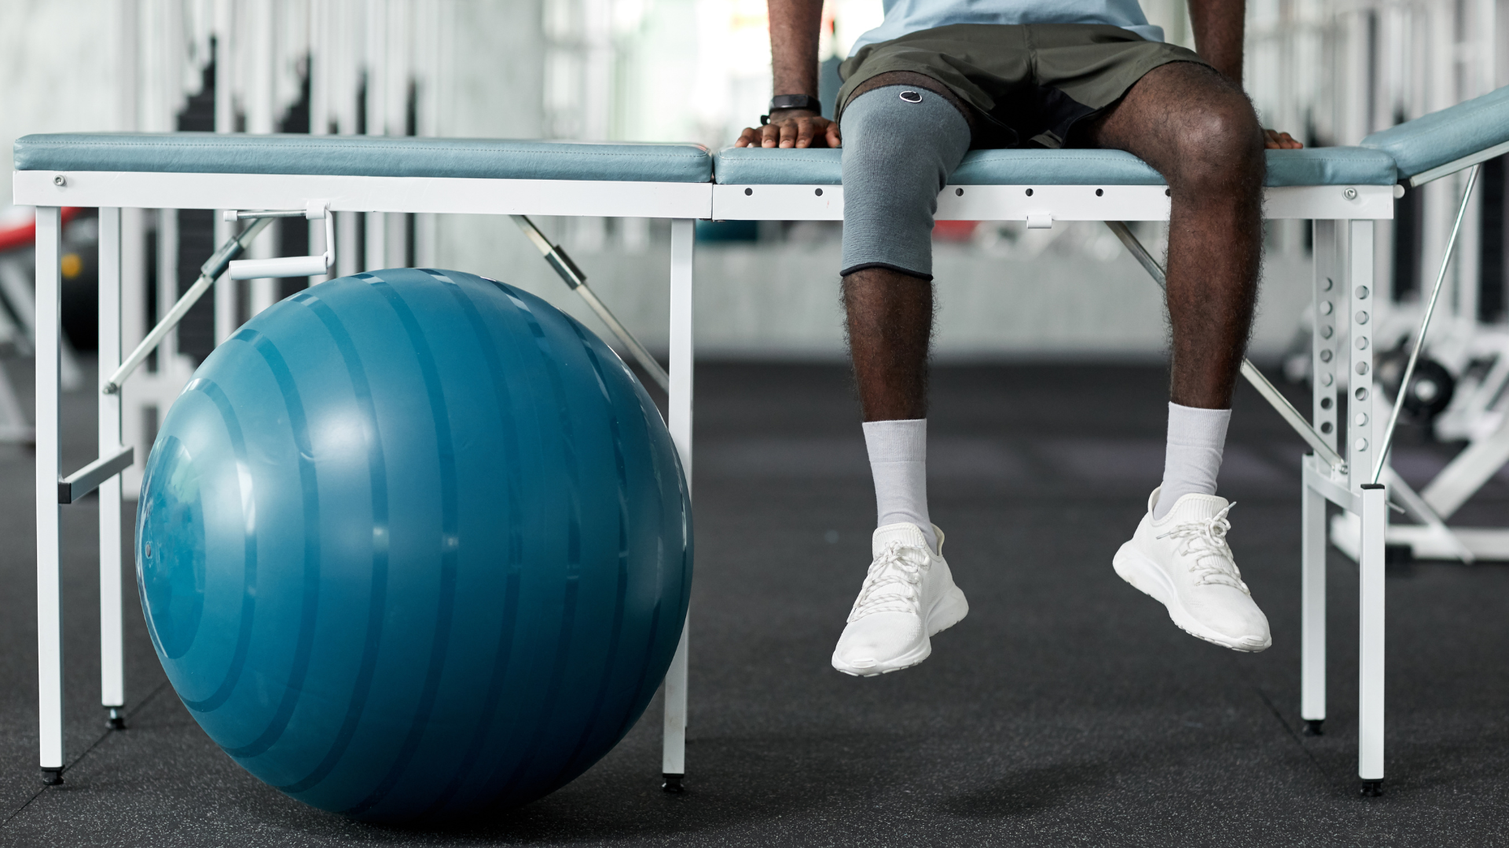

MS-SSR Graduate Outcomes
Survey Year | Response/ Knowledge Rate | *Working | *Not Seeking | *Continuing Education | *Military | *Volunteering | *Still Looking | *Satisfactorily Occupied
AY 2023-2024 (FA 23) | 89% | 88% | 0% | 4% | 0% | 0% | 8% | 92%
AY 22 – 23 (FA 22/SP 23/SU 23) | 78% | 95% | 0% | 3% | 1% | 0% | 1% | 99%
AY 21 – 22 (FA 21/SP 22/SU 22) | 68% | 79% | 0% | 13% | 0% | 0% | 8% | 92%
AY 20-21 (FA20/ SP21/SU21) | 67% | 81% | 0% | 8% | 2% | 2% | 7% | 93%
AY 19-20 (FA 19/SP 20/SU20) | 65% | 89% | 0% | 0% | 0% | 0% | 11% | 89%
AY 18-19 (SU 19) | 78% | 79% | 0% | 7% | 0% | 0% | 14% | 86%
*the % of surveys completed

Slide 2
Employers Who Have Hired Our Graduates
Absolute Wellness, PLLC
Active Mobility Chiropractor and Rehabilitation Group
Adolph & Kalkstein Chiropractic
Advanced Spine and Rehabilitation
Affordable Chiropractic
Airrosti Rehab Centers
Albert Einstein Healthcare Network
Aligned Modern Health
Amal Rehab Care
Amazon
AmeriWell
AQE Physical Therapy
Athletic Outcomes
Aquila
ATI Physical Therapy
Aylo Health
Back In Motion Chiropractic
Balanced Body Chiropractic
Barnes Chiropractic
Baseball Performance Center
Belgravia Leisure
Benton Chiropractic
Bethany College
Bledsoe Chiropractic
Body In Balance Chiropractic and Medical
Bolivar-Richburg Central School District
Boston Rhythmic
Boys & Girls Clubs of Central Alabama
Brigham Young University
Browning Chiropractic

Slide 3
Employers Who Have Hired Our Graduates
Cawley Physical Therapy and Rehab
Cerner Corporation
Chicago Chiropractic & Sports Injury Center
Children's Hospital Colorado
Chiro Concepts
Chiropractic, Massage, and Nutrition
Chiro One Wellness Centers
Claddagh Chiropractic Wellness Center
Colorado Springs School District 11
Complete Chiropractic Sports and Wellness
Comprehensive Chiropractic
Confluence Fitness
Coon Rapids-Bayard Community School District
Cornerstone Chiropractic
Crunch Fitness
Dade Christian School Athletics
Dae to Day Training and Nutrition LLC
Danville Chiropractic
Deeply Rooted Chiropractic
Denver Public Schools
Dicks Sporting Goods
Dosher Memorial Hospital
Dynamic Sports Medicine
ECC Healthcare
Elite Sports and Spine Chiropractic
Emory Healthcare
EXOS
Fontbonne University
Future

Slide 4
Employers Who Have Hired Our Graduates
Good2Go Chiropractic & Neuropathy Center
Graceland University
Greens Farms Academy
Greely High School
Haksha Healthcare
HCA Healthcare
Health Fitness
HealthSource America's Chiropractor
Hibbett Sports
Highlands Sport and Spine
Horizon Chiropractic
Huffman Family Chiropractic
Huffman Spine and Sports Chiropractic
Illinois Back Institute
Indy Spine and Rehab
Innovative Fitness
Inspire Physical & Hand Therapy
Integrative Spine and Sports
Iowa Back Pain Center
Island Health & Fitness
Jeffrey Oguin
Kalkstein Chiropractic
Kayal Orthopedic Center
Keough Chiropractic
Krisiak Chiropractic

Slide 5
Employers Who Have Hired Our Graduates
Lake Nona Performance Club
Legacy Health
Levelland Physical Therapy
Lifetime Activities
LINT Chiropractic
Loehr Health Center
Logan University
Mamba Sports Academy
Manchester Family Chiropractic
Massart Chiropractic
Memphis Spine and Sport
Metro Physical & Aquatic Therapy
Mid-South Chiropractic
Midwest Family Wellness
MMAC Health
Molloy College Athletic Department
Morrison Chiropractic, PA
Mountain Vista High School
MUSC Health
MWR Morale Welfare and Recreation USA

Slide 6
Employers Who Have Hired Our Graduates
Natural Potential Chiropractic
NEOH Functional Rehab
New York-Presbyterian - Columbia University Irving Medical Center
Next Level Family Chiropractic
NorthShore Health Centers
Norton Performance
Northwestern State University
Novo Chiropractic Sports and Wellness Center
Olympia Physical Therapy & Industrial Rehabilitation
100% Chiropractic
Optimum Physio Therapies
Ontario Ministry of Health

Slide 7
Employers Who Have Hired Our Graduates
Pacheco Spine and Sport
Paraquad
Peak Physical Therapy
Philadelphia 76ers
Physical Dimensions
Pinecrest Chiropractic
Pivot Physical Therapy
Post Acute Medical
Pro Health Physio
PT Link Physical Therapy
QLI
Quality Academy Prep
Randolph County School System
Reinhardt University
Restoration Spine and Sport
Reyes Holdings
Riot Dance Center
Rohlfs Chiropractic Care
Roundup Fellowship
RPI Therapy

Slide 8
Employers Who Have Hired Our Graduates
Saratoga Health and Wellness
Sauna Hut
Select Physical Therapy
Sevier Valley Chiropractic Clinic
Sherrill Chiropractic
Simple Truth Chiropractic
Sky Fitness
Solutions Integrated Medicine
South Lake Wellness and Injury Center, PL
Spectrum Health
Spine and Sports Center of Chicago
SSM Health
St. Louis Community College
St. Marks Medical Center
St. Mary's Academy
StretchLab Irvine
Summit Chiropractic
Swedish Medical Center

Slide 9
Employers Who Have Hired Our Graduates
Terrebonne General Medical Center
The FARM - Functional Athletic Rehabilitation & Movement
The Joint
The Sports Pod
The Neurologic Wellness Institute
The Wellness Way
Total Motion Performance, Wellness, and Rehabilitation
Trainology
Tross Spine and Sports Performance
Tucson Unified School District
Virginia Military Institute
UNC Wellness Centers
University of Kentucky
United States Army
United States Tennis Association
US Department of Veterans Affairs (VA)
Utah Valley University
Veterans Health Administration (VHA)
Vita
Wake County Public School System
West County Spine and Joint
Westwood Baptist Academy
Widom Chiropractic
William Fremd High School
Wills Chiropractic Clinic PC
Xperience Fitness

Slide 10
Sample Job Titles of MS-SSR Graduates
Adjunct Faculty
Health Fitness Professional
Chiropractor
Athletic Trainer
Advanced Practice Clinician
Clinical Assistant
Exercise Physiologist
Case Manager
Associate
Assistant Athletic Trainer
Fitness Specialist
Associate Head Strength and Conditioning Coach
Exercise Specialist Coordinator
Duty Manager
Health and Fitness Specialist
Injury Prevention Specialist
Assistant Manager
Assistant Strength & Conditioning Coach
Exercise Specialist
Head Coach
Head Athletic Trainer
Health and Physical Education Professor
Clinical Leader
Instructor
Lead Clinician
Assistant Coach
Athletic Facilities Coordinator
Advanced Clinical Associate
Chiropractic Tech
Clinic Director
CEO
Founder
Entrepreneur
Fitness Program Specialist
Durable Medical Equipment Coordinator
Fitness Coordinator

Slide 11
Sample Job Titles of MS-SSR Graduates
Physical Education Teacher
Patient Care Coordinator
Physical Therapy Aide
Recovery Specialist
Rehabilitation and Exercise Specialist
Movement Coach
Strength and Conditioning Coach
Orthopedic Technician
Unit Director
Research Associate
Personal Trainer
Operations Support Specialist
Rehabilitation Specialist
Rehabilitation Assistant
Neuro-rehabilitation Specialist
Return-to-Play Trainer
Patient Care Technician
Physical Ed. Teacher
Manager
Movement Specialist
Physical Therapy Technician
Recreation Therapist
Performance Coach
Rehab Specialist
Outreach Athletic Trainer
Therapy Tech
Owner

