Slide 1
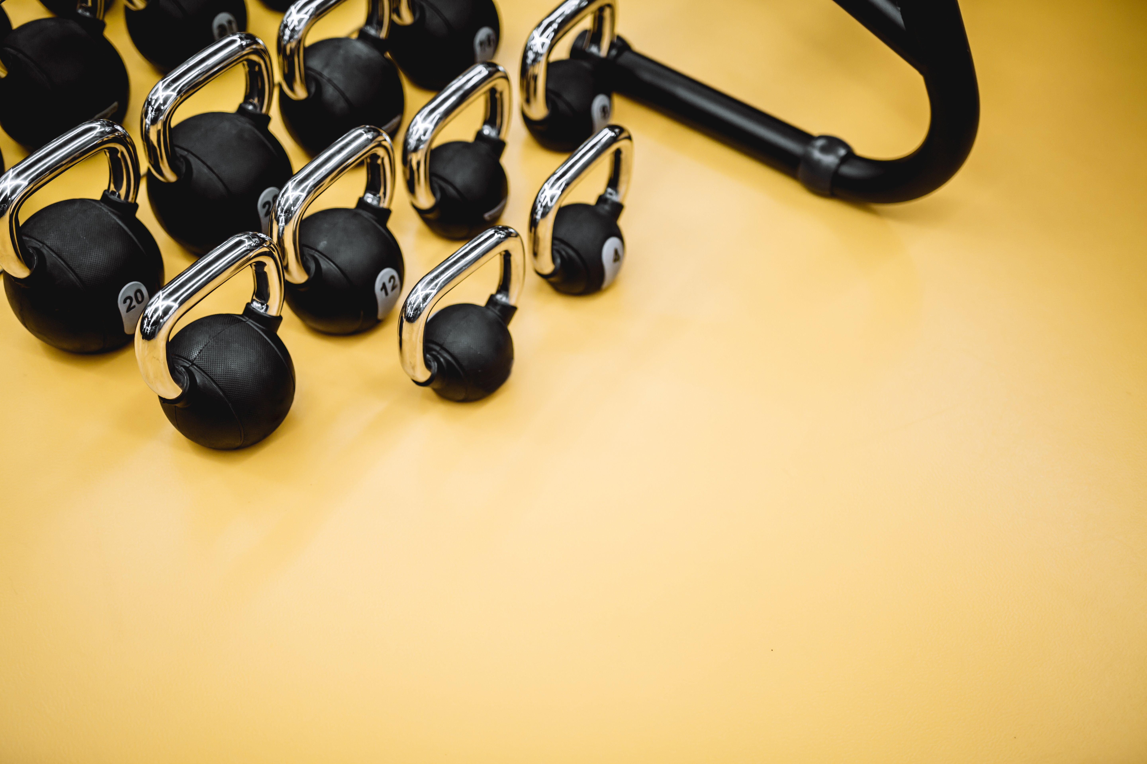

MS-SC Graduate Outcomes
Survey Year | Response/ Knowledge Rate | *Working | *Not Seeking | *Continuing Education | *Military | *Volunteering | *Still Looking | *Satisfactorily Occupied
AY 23-24 (FA 23) | 100% | 100% | 0% | 0% | 0% | 0% | 0% | 100%
AY 22-23 (SP 23/SU 23) | 79% | 80% | 0% | 10% | 0% | 0% | 10% | 90%
*the % of surveys completed

Slide 2
Employers Who Have Hired Our Graduates
Averett University
Central Institute for Human Performance
Champion Chiropractic and Sport Injury Clinic
D1 Sports Franchise, LLC
Elite Sports Injury Therapies
Exos
Impact Physical Therapy
Long Island University
Midland University
Ministry of Education
MuscleNerd Strength Training & Coaching
PAP Sports
Texas Christian University
The College of Wooster
Wellsville Local School District
William Jessup University

Slide 3
Sample Job Titles of MS-SC Graduates
Assistant Coach
Head Strength and Conditioning Coach
Strength and Conditioning Coach
Head Sports Performance Coach
Speed and Fitness Performance Coach
Coach
Owner
Physical Therapy Technician
Teacher

