Slide 1
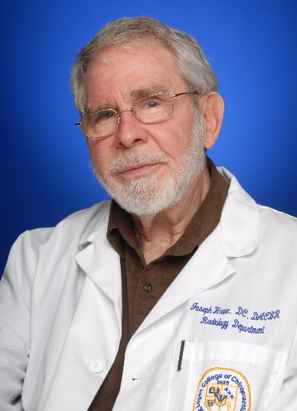


13th Annual Joseph W. Howe Oration in Diagnostic Imaging
“Neuroimaging the pain experience and brain mechanisms of acupuncture efficacy: A 20 year Logan-Martinos collaboration”
Presented By:
Vitaly Napadow, PhD, LicAc
Friday, October 16, 2020 11:30 am – 12:30 pm
Virtual Event

